Slide 1
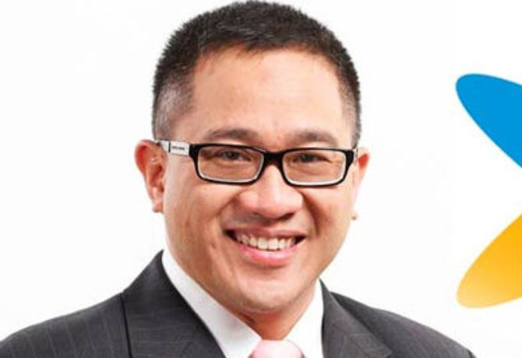
GUEST LECTURE
Alexander Rusli Ph.D.
President Director and CEO at Indosat Ooredoo
Indonesia Telecommunications
IT STRATEGIC PLAN
FRIDAY, APRIL 15, 2016 @ 7 - 9 PM
MTI UI, SALEMBA

